Slide 1


Technovation hackathon & innovation budge
MAHARAJA AGRASEN INSTITUTE OF TECHNOLOGY
LEADER-
SURYASH KUMAR JHA
MEMBERS-
VISHAL
ANURAG SINGH
SK SAHIL AFRIDI ALI
Team name :- dare2code
TEAM NO.-SSSS-1120

Slide 2
PROBLEM :Design and develop a solution to utilize existing camera feed without jeopardizing the main objective of general surveillance and provide Vehicle license plate number recognition functionality.
DESCRIPTION OF IDEA:
👉Create a model that will detect a car in a live stream or video and recognize characters on the number plate of the car. (using open CV , Pytesseract , Tensor Flow)
👉Secondly, it will use the characters and fetch the owner's information using RTO APIs.
👉Create a Web portal where all this information will be displayed. (using HTML, CSS, JS and Flask)

Slide 3
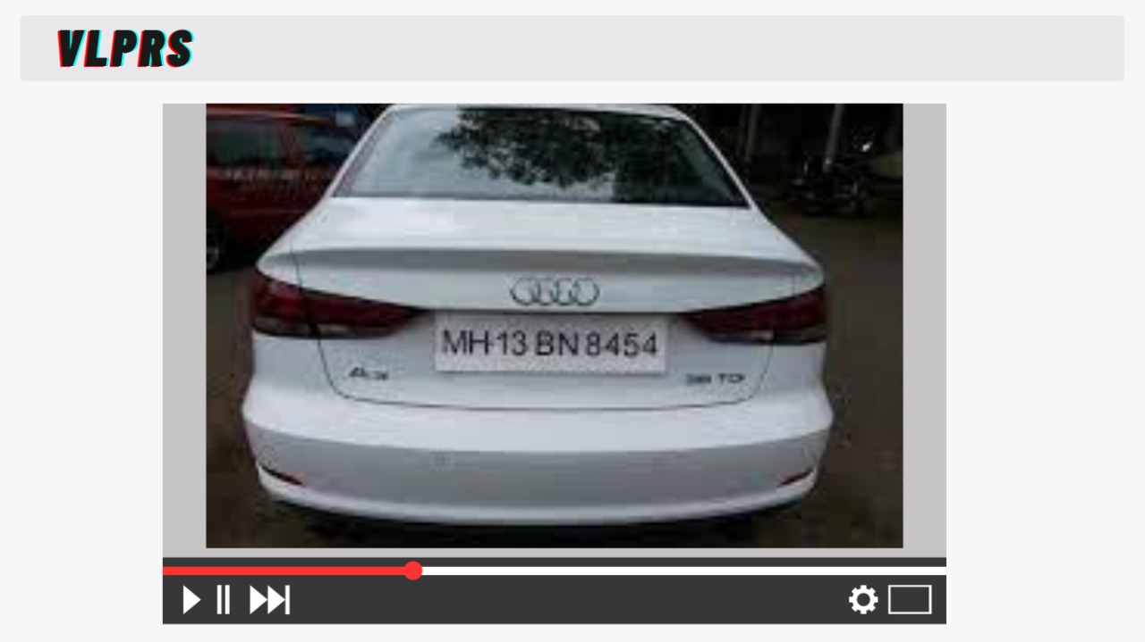
ANPR (AUTOMATIC NUMBER PLATE RECOGNITION)
WORKING OF ANPR SYSTEM :
The camera of the ANPR system captures image of vehicle license plate and then the image is processed through multiple number of algorithms to provide an alpha numeric conversion of the image into a text format.
PLACES WHERE ANPR SYSTEM CAN BE USED :
ANPR system can be used at many places like Petrol Pumps, Airports , Highways, toll booths, Parking lots, Defense & Military check points, Stolen cars, etc.
Sneak peek

Slide 4
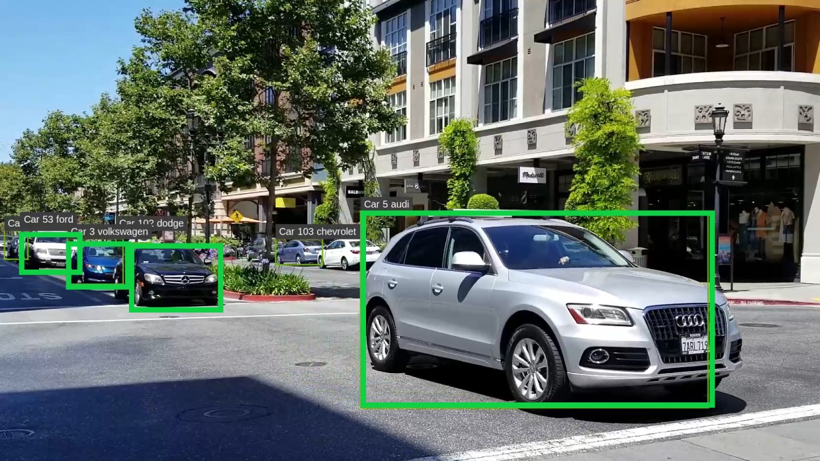
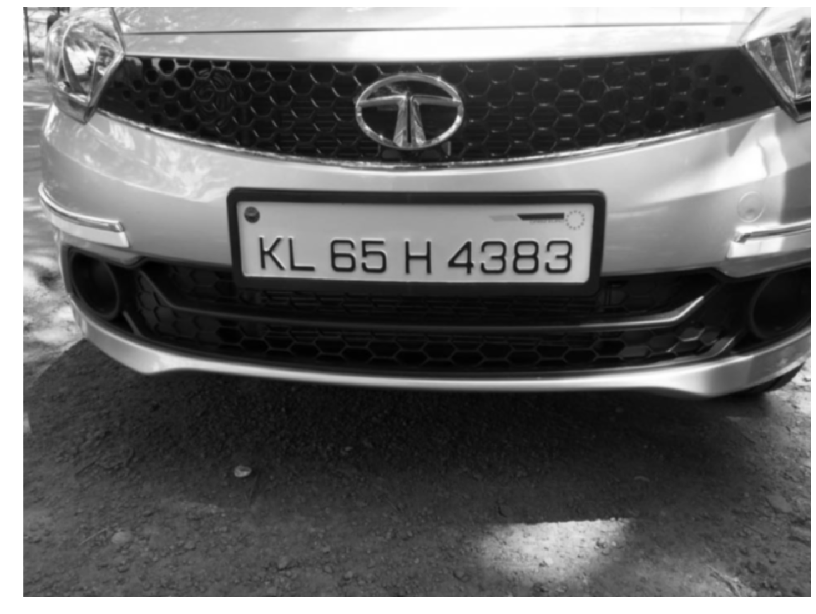
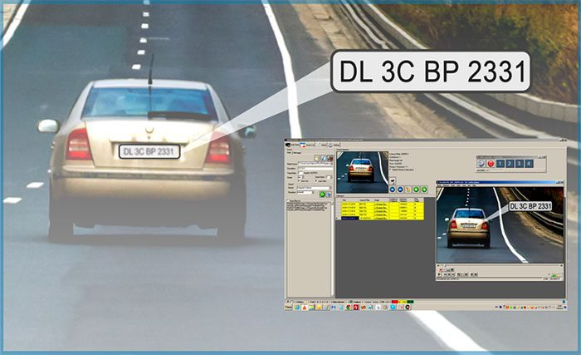
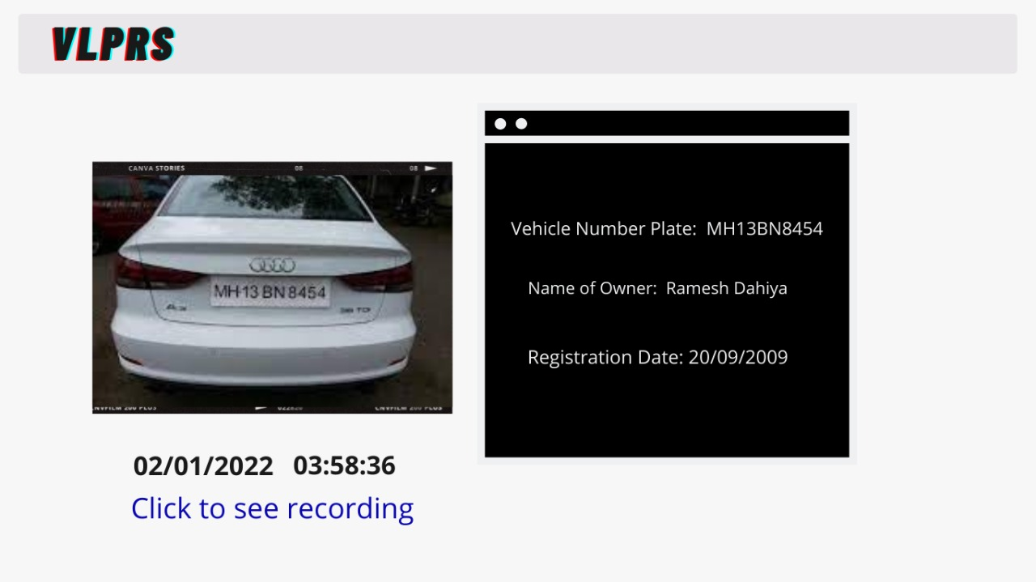
Description of Applicability
DETECTION OF VEHICLES
CAPTURE OF IMAGES
PROCESS OF RECOGNITION
FINAL OUTPUT

Slide 5
CONCLUSION
There is an immediate need of such kind of Automatic Number Plate Recognition system in India as there are problems of traffic, stealing cars, etc.
Government should take some interest in developing this system as this system is very economical and eco-friendly, if applied effectively.
ADVANTAGES:
DISADVANTAGES:
Improving road safety
Reduces crime.
Gives officers better information to work with.
Deterring terrorism
Increasing the percentage of stop/searches that lead to an arrest.
Firstly, the images of the plate or of any object which is taken by using the optical character reader technology may get blurred mainly due to reason of motion blurring for which the picture seems to be hazy when uploaded in the database.
Secondly, the technology often uses low-resolution images.
Thank you

